Slide 1
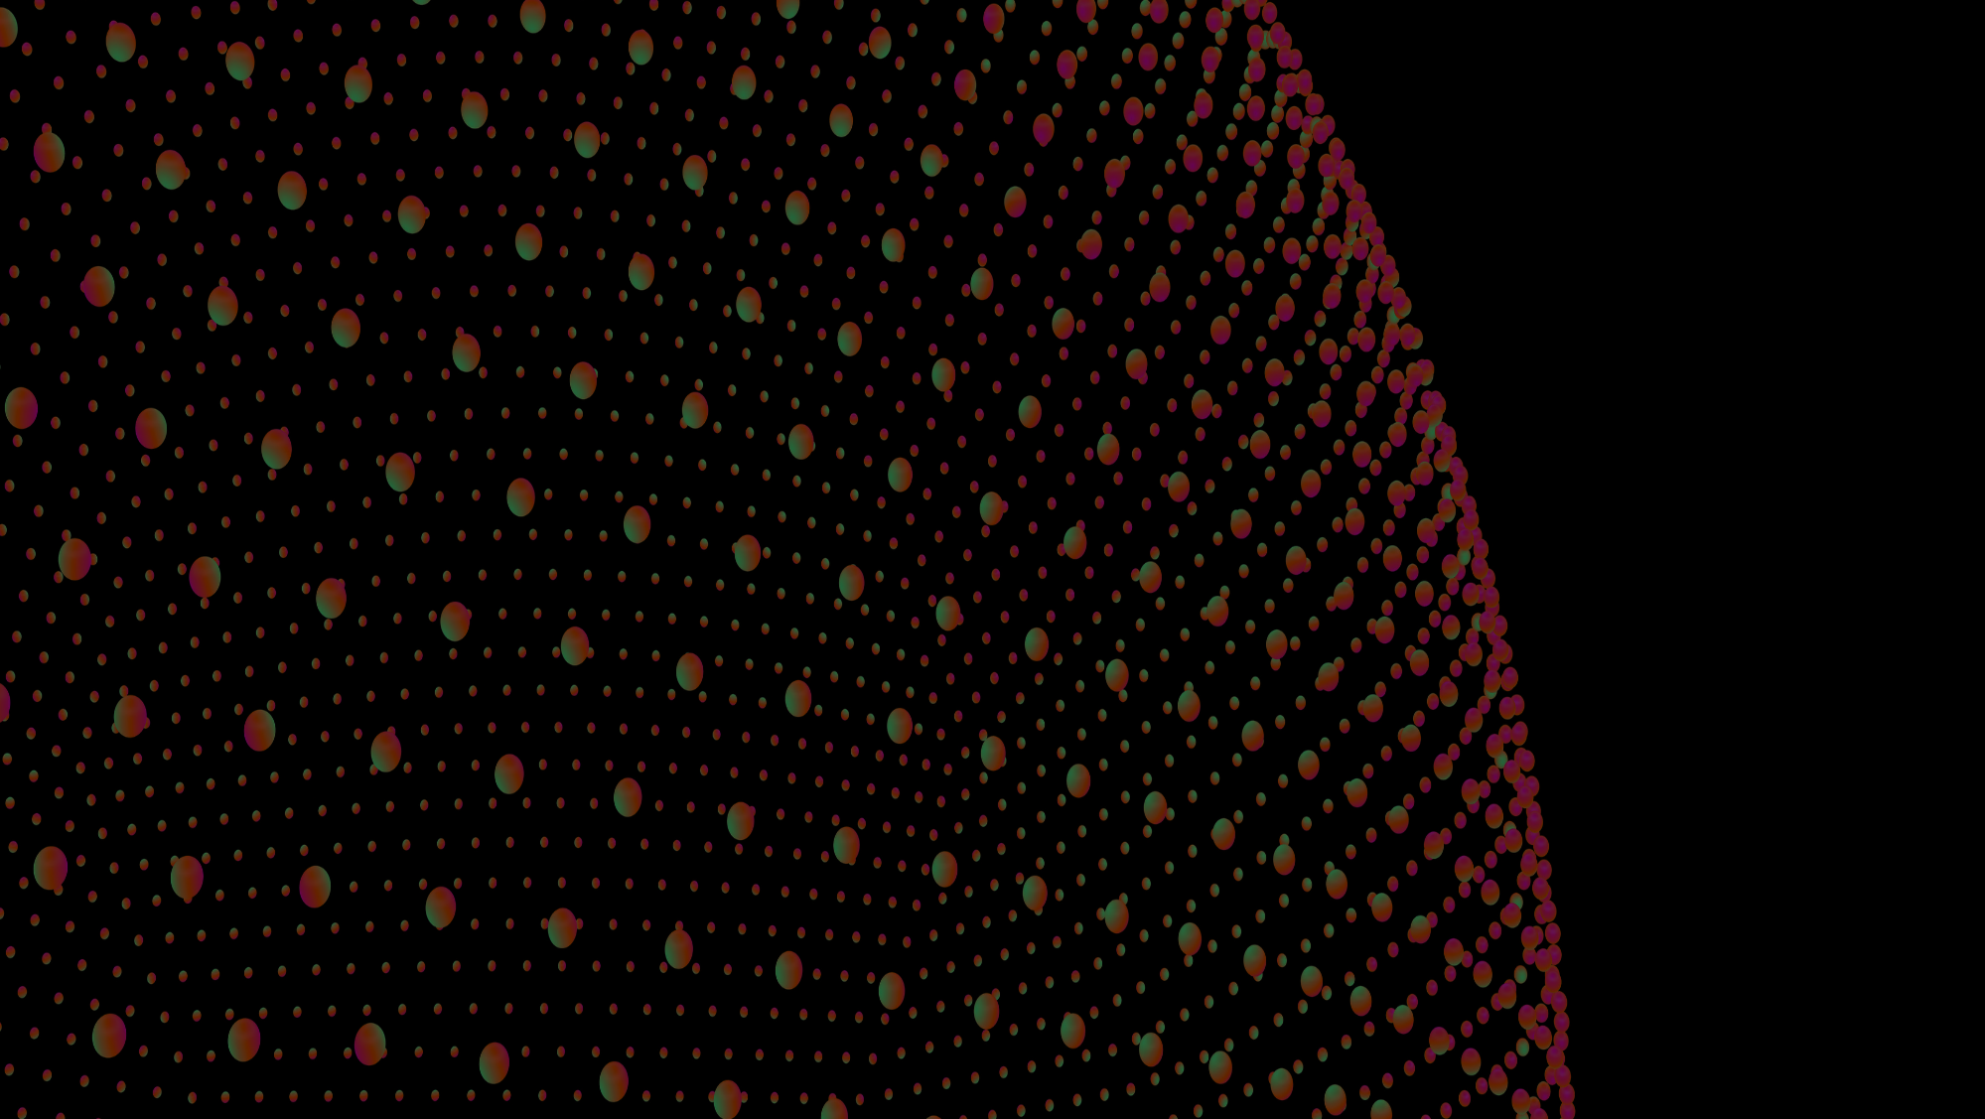
NEUROMORPHIC TECHNOLOGY
Vinit Kumar

Slide 2
What is NEUROMORPHIC TECHNOLOGY
Computer Engineering Branch
It is a Method where the computational requirements in modern computers are modelled after the very complex Nervous Systems and Human brain.(Neurons)

Slide 3

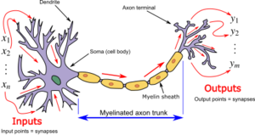
What is NEURON ??

Slide 4

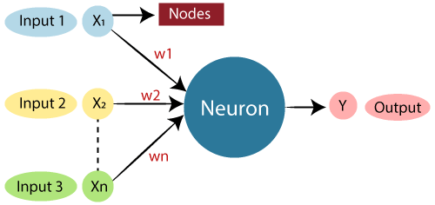
What is NEURON ??
Biological Neural Network | Artificial Neural Network
Dendrites | Inputs
Cell nucleus | Nodes
Synapse | Weights
Axon | Output

Slide 5
Building Neuron
Layer of 3 NEURONS (Static way of doing it)
inputs = [1, 2, 3, 2.5]
weights1 = [0.2, 0.8, -0.5, 1.0]
weights2 = [0.5, -0.91, 0.26, -0.5]
weights3 = [-0.26, -0.27, 0.17, 0.87]
bias1 = 2
bias2 = 3
bias3 = 0.5
output = [inputs[0]*weights1[0] + inputs[1]*weights1[1] + inputs[2]*weights1[2] + inputs[3]*weights1[3] + bias1,
inputs[0]*weights2[0] + inputs[1]*weights2[1] + inputs[2]*weights2[2] + inputs[3]*weights2[3] + bias2,
inputs[0]*weights3[0] + inputs[1]*weights3[1] + inputs[2]*weights3[2] + inputs[3]*weights3[3] + bias3]
print(output)
>>> [4.8, 1.21, 2.385]

Slide 6
Building Neuron
Layer of 3 NEURONS (Dynamic way of doing it)
inputs = [1, 2, 3, 2.5]
weights = [[0.2, 0.8, -0.5, 1.0],
[0.5, -0.91, 0.26, -0.5],
[-0.26, -0.27, 0.17, 0.87]]
bias = [2, 3, 0.5]
layer_outputs = [] # Output of current layer
for neuron_weights, neuron_bias in zip(weights, bias): # zip is used to iterate over multiple lists at once
neuron_output = 0 # Output of given neuron
for n_input, weight in zip(inputs, neuron_weights):
neuron_output += n_input * weight # Multiply this input by associated weight and add to the neuron's output variable
neuron_output += neuron_bias # Add bias to the neuron's output
layer_outputs.append(neuron_output)
print(layer_outputs)
>>> [4.8, 1.21, 2.385]

Slide 7
Building Neuron
Using Numpy for building 1 neuron
import numpy as np
inputs = [1, 2, 3, 2.5]
weights = [0.2, 0.8, -0.5, 1.0]
bias = 2
output = np.dot(weights, inputs) + bias # np.dot() is used to multiply two arrays
print(output)
>>> 4.8

Slide 8
Building Neuron
# Using Numpy for a layer of neurons # import numpy as np
inputs = [1, 2, 3, 2.5]
weights = [[0.2, 0.8, -0.5, 1.0],
[0.5, -0.91, 0.26, -0.5],
[-0.26, -0.27, 0.17, 0.87]]
biases = [2, 3, 0.5]
output = np.dot(weights, inputs) + biases
print(output) #-----------------------------------------------------------#
>>> [4.8 1.21 2.385]

Slide 9
Building Neuron
# Using Numpy for a batch of data # import numpy as np
inputs = [[1, 2, 3, 2.5],
[2.0, 5.0, -1.0, 2.0],
[-1.5, 2.7, 3.3, -0.8]]
weights = [[0.2, 0.8, -0.5, 1.0],
[0.5, -0.91, 0.26, -0.5],
[-0.26, -0.27, 0.17, 0.87]]
print(np.array(inputs).shape)
print(np.array(weights).shape)
print(np.array(weights).T.shape)
biases = [2, 3, 0.5]
output = np.dot(inputs, np.array(weights).T) + biases
print(output)
#-----------------------------------------------------------#
>>>
(3, 4)
(3, 4)
(4, 3)
[[ 4.8 1.21 2.385]
[ 8.9 -1.81 0.2 ]
[ 1.41 1.051 0.026]]

Slide 10
Building Neuron
# Using Numpy for a batch of data (2 layers) # import numpy as np
inputs = [[1, 2, 3, 2.5],
[2.0, 5.0, -1.0, 2.0],
[-1.5, 2.7, 3.3, -0.8]]
weights1 = [[0.2, 0.8, -0.5, 1.0],
[0.5, -0.91, 0.26, -0.5],
[-0.26, -0.27, 0.17, 0.87]]
weights2 = [[0.1, -0.14, 0.5],
[-0.5, 0.12, -0.33],
[-0.44, 0.73, -0.13]]
biases1 = [2, 3, 0.5]
biases2 = [-1, 2, -0.5]
layer1_outputs = np.dot(inputs, np.array(weights1).T) + biases1
layer2_outputs = np.dot(layer1_outputs, np.array(weights2).T) + biases2
print(layer2_outputs)
#-----------------------------------------------------------#
>>>
[[ 0.5031 -1.04185 -2.03875]
[ 0.2434 -2.7332 -5.7633 ]
[-0.99314 1.41254 -0.35655]]

Slide 11
Building Neuron
>>>
[[ 0.148296 -0.08397602]
[ 0.14100315 -0.01340469]
[ 0.20124979 -0.07290616]]
# Using Numpy for a batch of data (2 layers) # import numpy as np
np.random.seed(0)
X = [[1, 2, 3, 2.5],
[2.0, 5.0, -1.0, 2.0],
[-1.5, 2.7, 3.3, -0.8]]
class Layer_Dense:
def __init__(self, n_inputs, n_neurons):
self.weights = 0.10 * np.random.randn(n_inputs, n_neurons) # 0.10 is used to scale the values to a useful range
# np.random.randn() is used to create an array of random numbers
# n_inputs is the number of inputs and n_neurons is the number of neurons
# so the shape of the array will be (n_inputs, n_neurons)
self.biases = np.zeros((1, n_neurons)) # np.zeros() is used to create an array of zeros # shape = (1, n_neurons)
def forward(self, inputs):
self.output = np.dot(inputs, self.weights) + self.biases
# print(0.10*np.random.randn(4, 3))
layer1 = Layer_Dense(4, 5) # 4 inputs, 5 neurons
layer2 = Layer_Dense(5, 2) # 5 inputs, 2 neurons
layer1.forward(X)
#print(layer1.output)
layer2.forward(layer1.output)
print(layer2.output)
#-----------------------------------------------------------#

Slide 12
Building Neuron
>>>
[0, 2, 0, 3.3, 0, 1.1, 2.2, 0]
# Usage of Activation Function (ReLU) # import numpy as np
np.random.seed(0)
X = [[1, 2, 3, 2.5],
[2.0, 5.0, -1.0, 2.0],
[-1.5, 2.7, 3.3, -0.8]]
inputs = [0, 2, -1, 3.3, -2.7, 1.1, 2.2, -100]
output = []
# ReLU Activation Function
'''
for i in inputs:
if i > 0:
output.append(i)
elif i <= 0:
output.append(0)
'''
for i in inputs: # Smatter way of doing it
output.append(max(0, i))
print(output)
#-----------------------------------------------------------#

Slide 13
Building Neuron
# Usage of Activation Function (ReLU) # import numpy as np
np.random.seed(0) X = [[1, 2, 3, 2.5],
[2.0, 5.0, -1.0, 2.0],
[-1.5, 2.7, 3.3, -0.8]]
class Layer_Dense:
def __init__(self, n_inputs, n_neurons):
self.weights = 0.10 * np.random.randn(n_inputs, n_neurons) # 0.10 is used to scale the values to a useful range
# np.random.randn() is used to create an array of random numbers
# n_inputs is the number of inputs and n_neurons is the number of neurons
# so the shape of the array will be (n_inputs, n_neurons)
self.biases = np.zeros((1, n_neurons)) # np.zeros() is used to create an array of zeros # shape = (1, n_neurons)
def forward(self, inputs):
self.output = np.dot(inputs, self.weights) + self.biases
class Activation_ReLU:
def forward(self, inputs):
self.output = np.maximum(0, inputs)
layer1 = Layer_Dense(4, 5) # 4 inputs, 5 neurons
activation1 = Activation_ReLU()
layer1.forward(X)
print(layer1.output) activation1.forward(layer1.output)
print(activation1.output)
#-----------------------------------------------------------#
>>>
[[ 0.10758131 1.03983522 0.24462411 0.31821498 0.18851053]
[-0.08349796 0.70846411 0.00293357 0.44701525 0.36360538]
[-0.50763245 0.55688422 0.07987797 -0.34889573 0.04553042]]
[[0.10758131 1.03983522 0.24462411 0.31821498 0.18851053]
[0. 0.70846411 0.00293357 0.44701525 0.36360538]
[0. 0.55688422 0.07987797 0. 0.04553042]]

